Slide 1
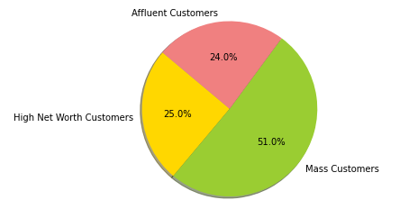
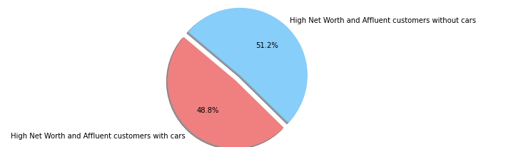
Distribution of Wealth Segments
High Net Worth/Affluent Customers with and without cars

Slide 2
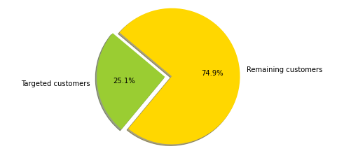
The Final Customer Segment - The Overlap between Affluent/High Net Worth and non-car owners

Slide 3
Based on our findings, we can conclude that the 25% portion of the customers, representing customers who are high networth/affluent non-car owners, have the highest customer value.
To maximize profits, Sprocket Central should center their marketing and growth strategy around customers who are non-car owners, as they will be more likely to purchase more bikes and bike supplies. Sprocket may find it beneficial to utilize external research and datasets regarding specific demographics of non-car owners, such as city of residence, in order to prioritize advertisement and marketing in those key areas.

